Slide 1
Assessment of Geolocation data impact on Housing Prices in King County, WA
IBM Applied Data Science Capstone project
September 22, 2019

Slide 2
Housing prices
Impact individuals, families as well as whole economy
Need of professional appraisal
Depend on a number internal features, such as size, number of bedrooms & bathrooms, etc
Certainly depend on location, though it is unclear what impacts the most
Predicting prices is important for dynamic pricing and might guide the future infrastructure development

Slide 3
Data Acquisition
https://www.kaggle.com/harlfoxem/housesalesprediction/downloads/housesalesprediction.zip [main dataset]
Foursquare Places API [number of nearby venues]
http://ciclt.net [zip codes database]

Slide 4
Data Cleaning
Remove all duplicates
Fill missing price values
Drop irrelevant or unfilled features
Add information on number of venues within 1 km radius using Foursquare API

Slide 5
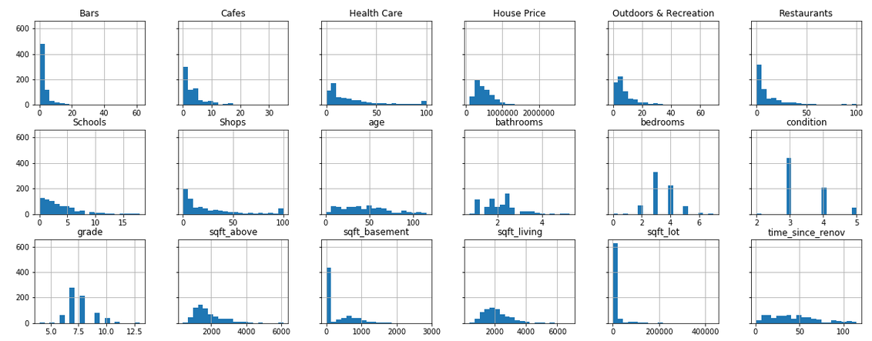
Data Exploration: Histograms

Slide 6
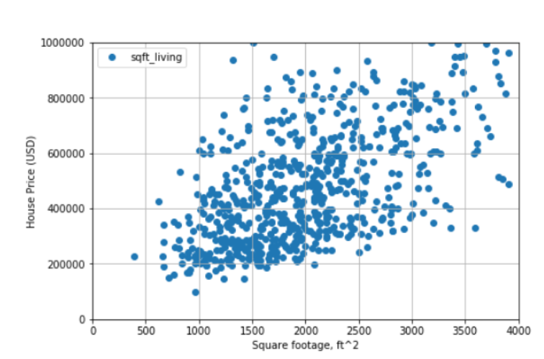
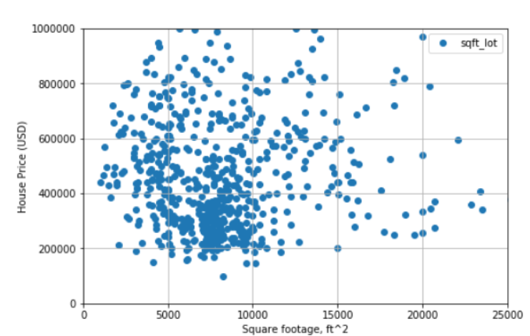
Data Exploration: Correlations

Slide 7
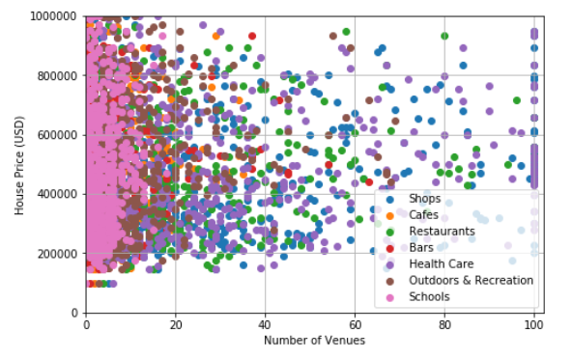
Data Exploration: Correlations

Slide 8
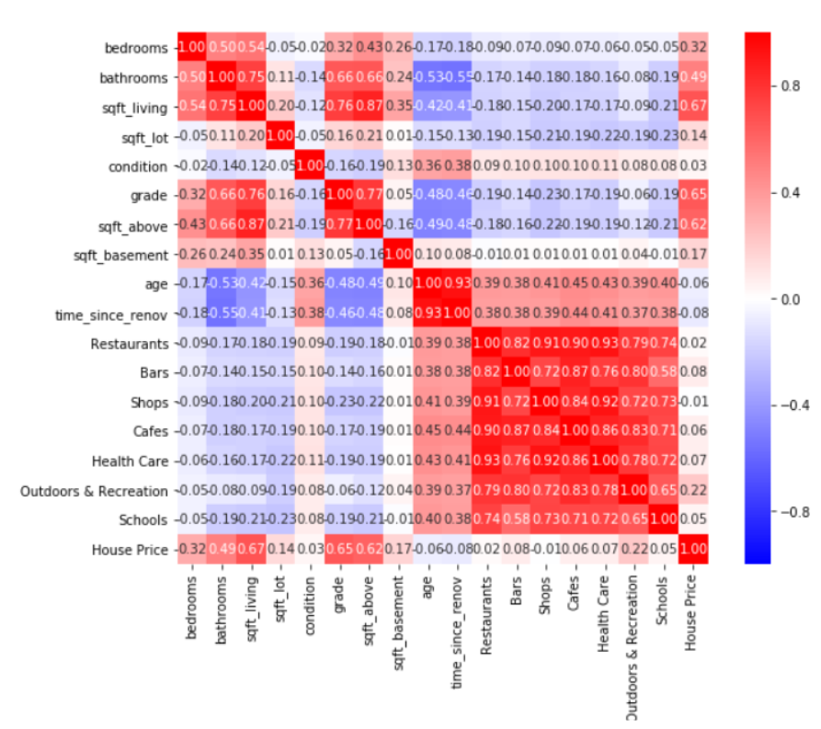
Data Exploration: Correlations

Slide 9
Models: Feature Selection
Model All Stats
Model Selected Stats
Model All Stats & All Venues
Model All Stats & Selected Venues

Slide 10
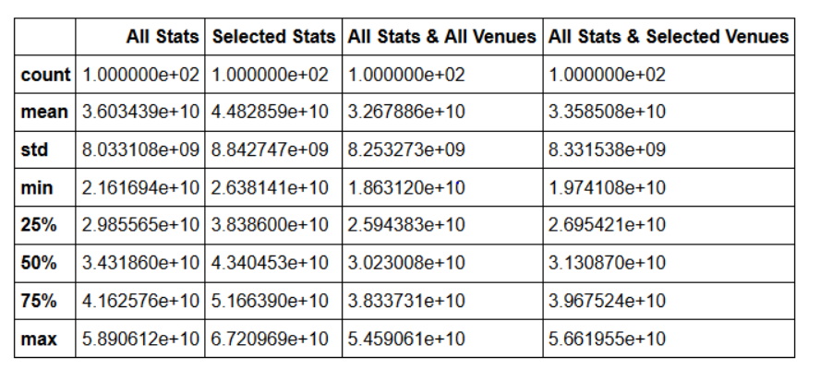
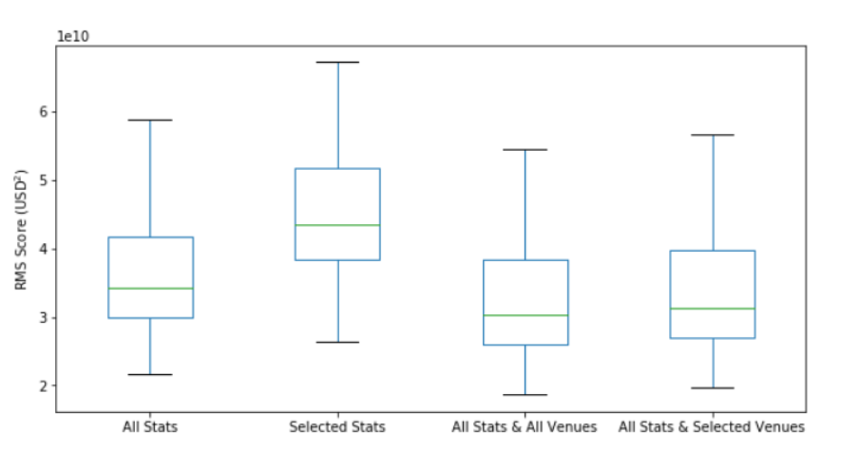
Models Evaluation: RMS

Slide 11
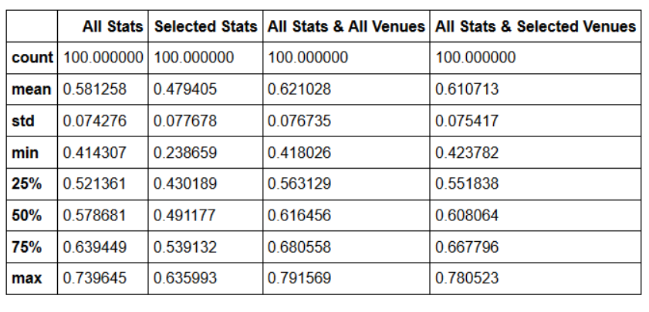
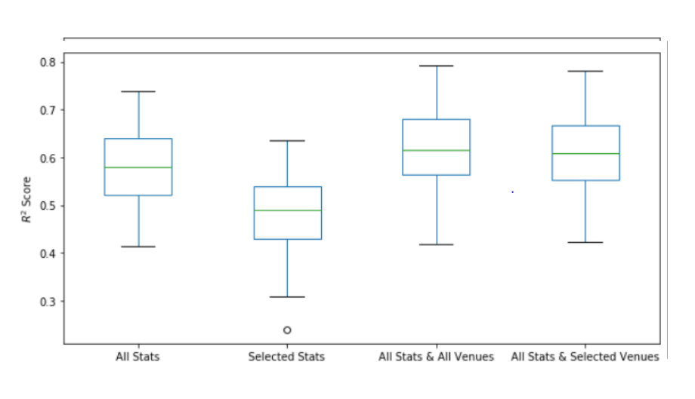
Models Evaluation: R²

Slide 12
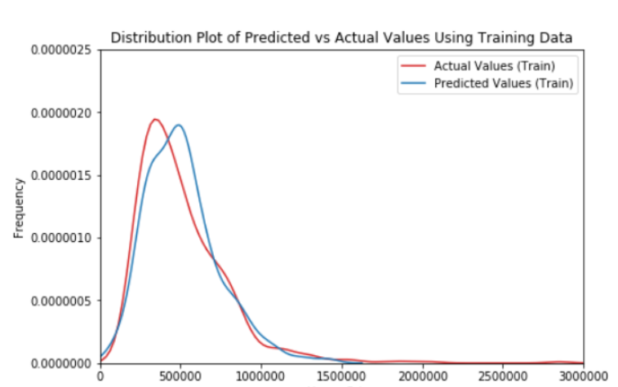
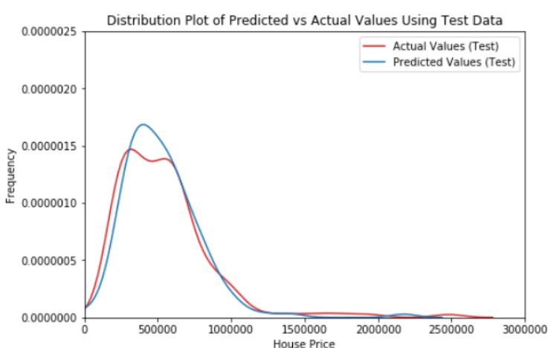
Best Model Performance

Slide 13
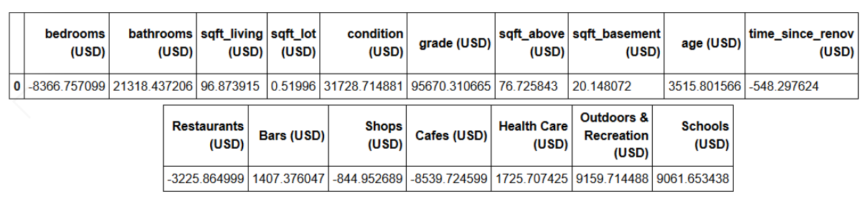
Best Model Coefficients
Coefficients suggest that the best predictors are:
Sqft_living
Grade
Outdoors & Recreation venues

Slide 14
Conclusions
Including the number of nearby venues especially outdoors facilities improves the model performance
Improvement is relatively small but the effect is robust: the infrastructure is important
Model improvement ideas:
More specific venue selection/filter venue datasets/adjust the search radius
Add more stats such as crime rate
Explore residuals for any non-linear behavior
Cluster neighborhoods for more insights

